Slide 1
Natural Language Processing (CSE431/CSE712)
Group-4
Md Faisal Ahmed ID: 21341042
Md. Tawhid Anwar ID: 21166002
Sifat Tanvir ID: 21166031
Ramkrishna Saha ID: 21166004
Syed Zamil Hasan Shoumo ID:21166008

Slide 2
Cybersecurity News Dataset and Exploratory
Analysis for Early Detection of Threat
Extracted from “The Hacker News”
Total 3742 news articles
1408035 word count in the corpus
4 type of news category of Label : : ‘Cyber Attack’, ‘Malware’, ‘Vulnerability’ and ‘Data Breaches’

Slide 3
Literature Review
Paper | Author’s Name | Year of publication | Used Method
Early Detection of Vulnerabilities from News Websites using Machine Learning Models | Denis Iorga, et. Al | 2020 | BERT
Cyber-Attack Features for Detecting Cyber Threat Incidents from Online News | Abdullah, et al. | 2018 | Conditional Random Field (CRF)
Automatic Identification of Indicators of Compromise using Neural-Based Sequence Labelling | S. Zhou et al. | 2018 | BiLSTM,CRF
TTPDrill: Automatic and Accurate Extraction of Threat Actions from Unstructured Text of CTI Sources | G. Husari et al. | 2017 | SVM
Acing the IOC Game: Toward Automatic Discovery and Analysis of OpenSource Cyber Threat Intelligence | X. Liao, et al. | 2016 | SVM

Slide 4
Experimental Design
Using Selenium and python
Fully automated data collection without any human error
All extracted data combined in a Excel file

Slide 5
Data Description and Analysis
Variable | Type | Description
Title | Text | Title of the news article
Link | URL | URL of the news article
Article | Text | Text of the news article
Label | Categorical | Category of the news article

Slide 6
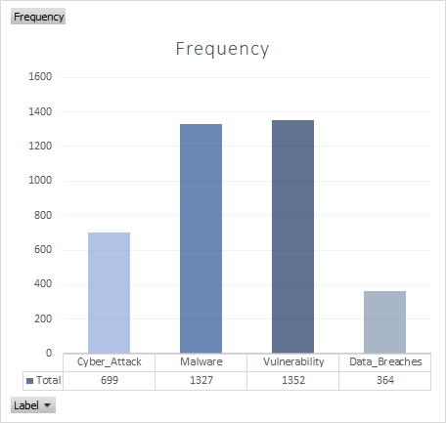
Data Description and Analysis

Slide 7
Data Description and Analysis
Label | Frequency | Percentage
Cyber_Attack | 699 | 18.68%
Malware | 1327 | 35.46%
Vulnerability | 1352 | 36.13%
Data_Breaches | 364 | 9.72%

Slide 8
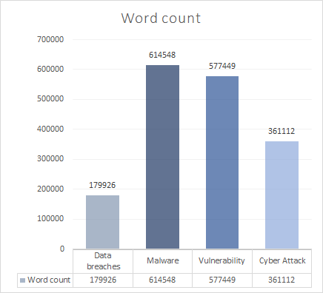
Data Description and Analysis

Slide 9
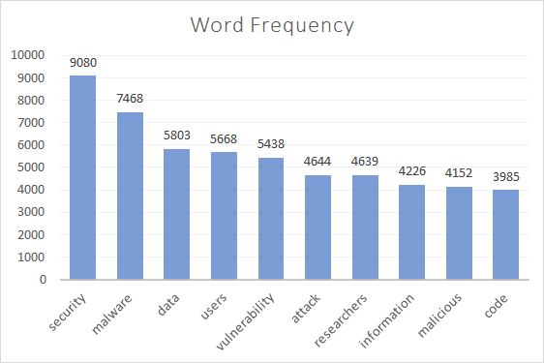
Data Description and Analysis

Slide 10
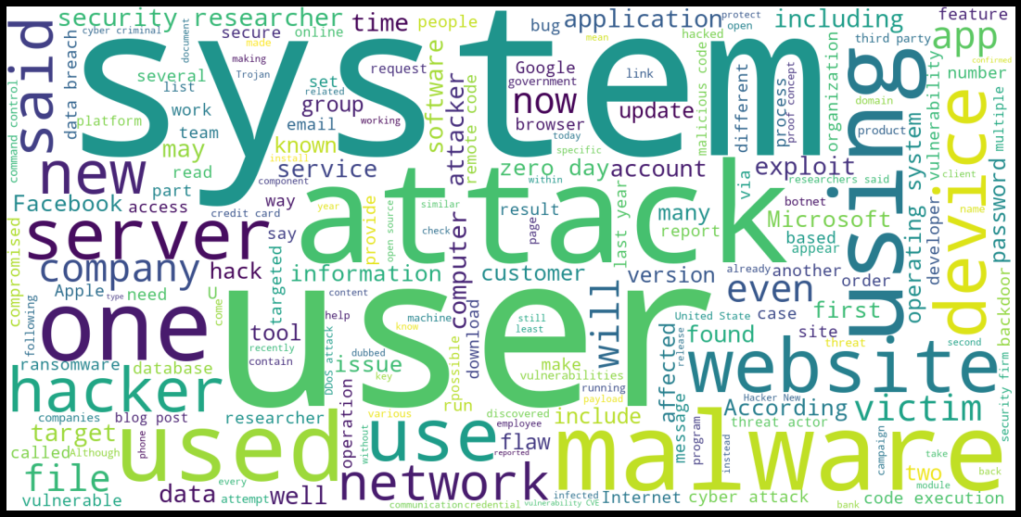
Data Description and Analysis

Slide 11
Methods to Explore
Machine learning approaches for classification: SVM, Multinomial Naïve Bayes Classifier, Random Forest classifier
RNN architectures: CNN, BiLSTM
Language Models: BERT, RoBERTa, XLNET, DistilBERT,
Others: NER, N-gram, CRF

Slide 12
Potential Challenges
Biased result due to imbalance Dataset
Data processing, Tokenization
Overfitting and Underfitting
Complexity of the algorithm
Training time

Slide 13
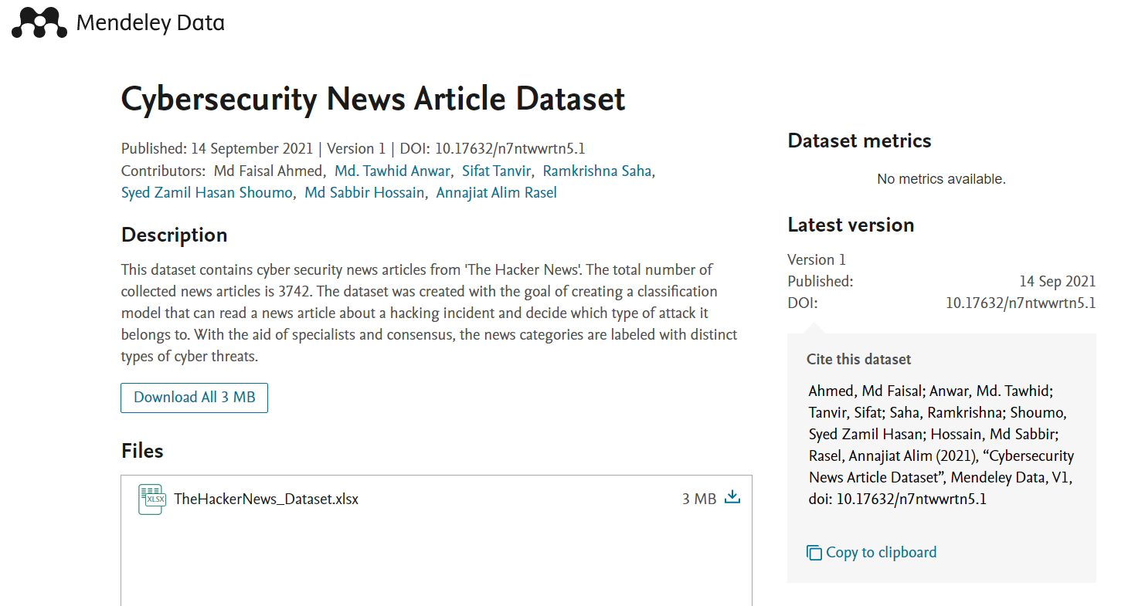
Conclusion

